Slide 1
Ensemble Learning of Multiple Pre-trained Models for Data Efficient Defect Detection
Team: Lusterinc
Pengcheng Gao, Bodi Wang, Mengshu Liu, Xi Yang, Yuming Quan, Yan Zhao, Yongliang Tang
Institute of Intellectual Rationality, LUSTER Light Tech Co.

Slide 2
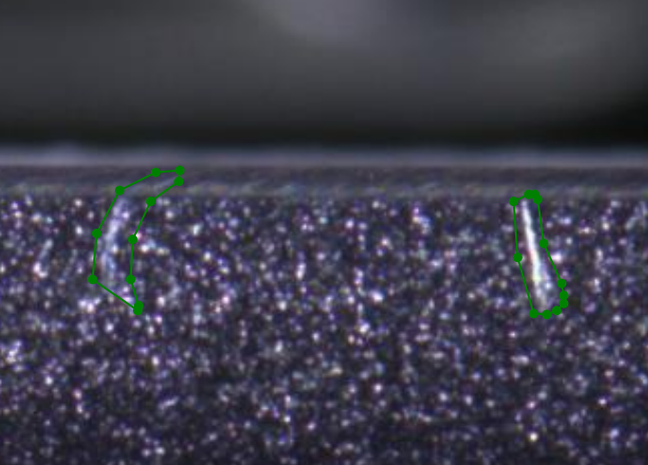
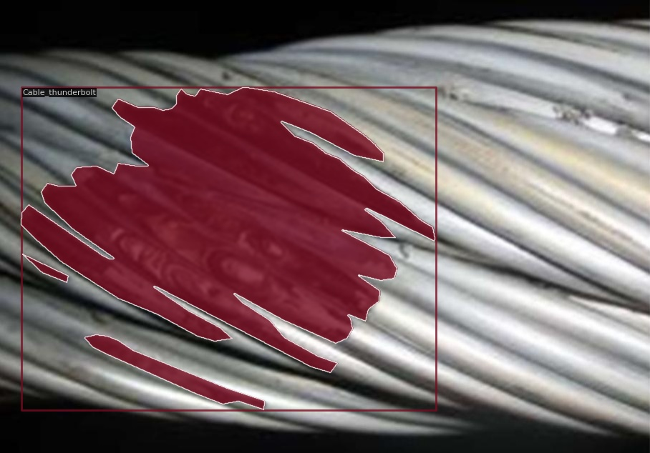
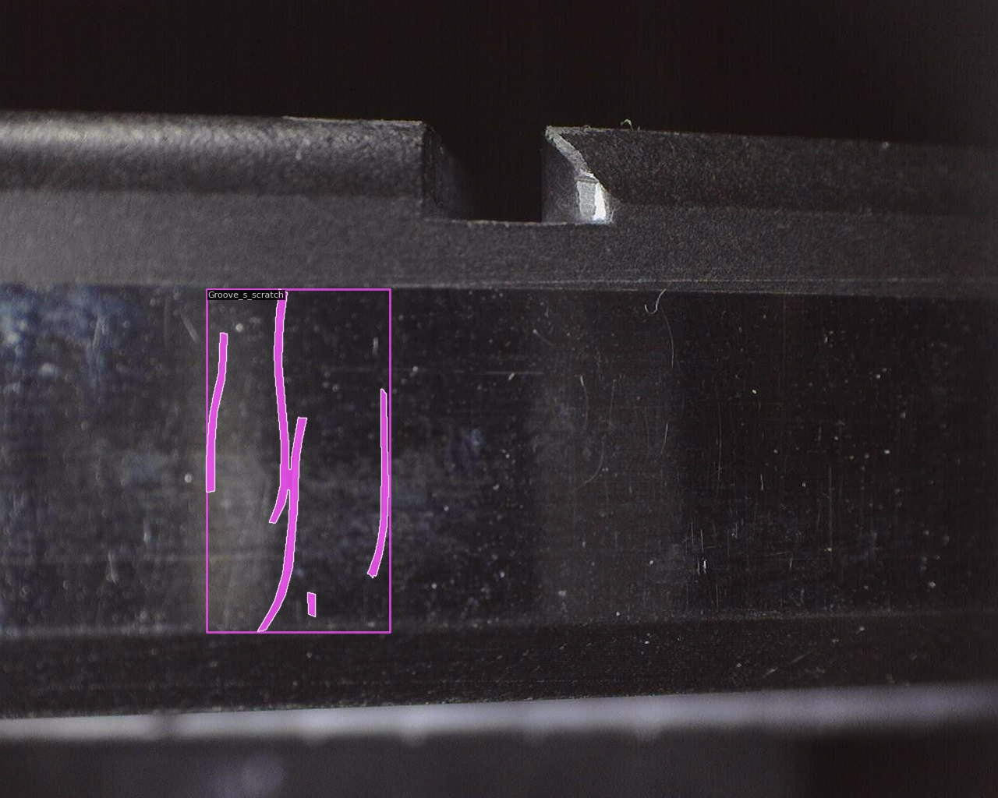
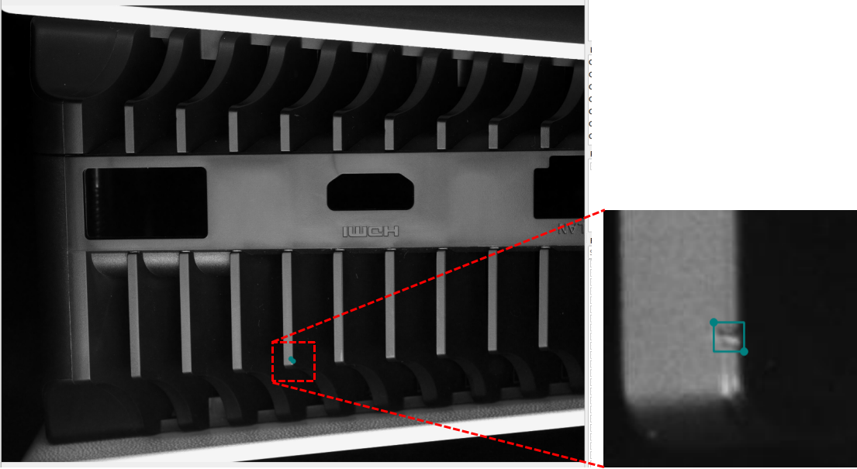
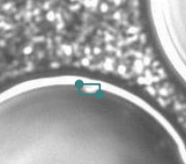
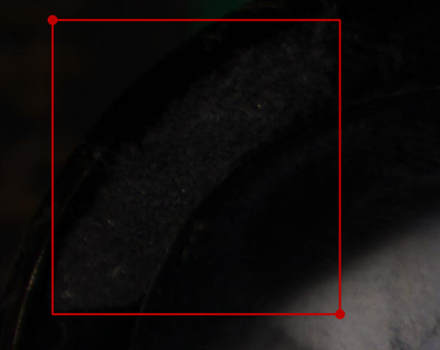
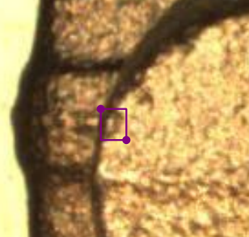
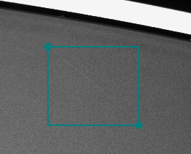
Task Description
Data Efficient Defect Detection——Instance segmentation
Main challenges:
Limited Annotation Data
Defects are small, shallow and weak

Slide 3
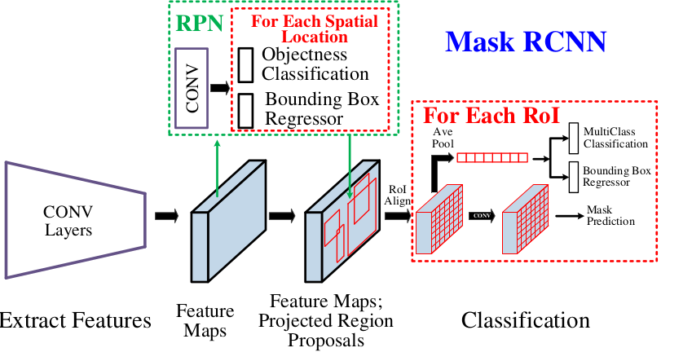
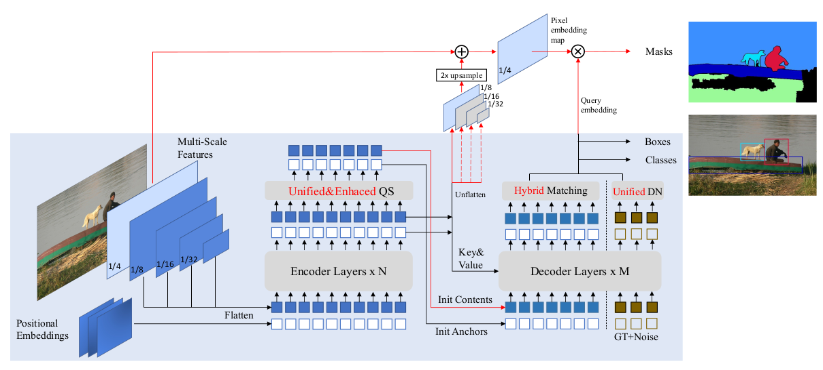
Our Solution
CNN Architecture
Limited Annotation Data
Hybrid Dataset Training
Pre-trained Model Finetuning
Cascade Mask RCNN with EVA
Defects are small, shallow and weak
Heterogeneous model ensemble learning
Result Fusion with tricks
EVA
MaskDINO
Result Fusion
Hybrid Dataset Training
Predicted results
Transformer Architecture
Heterogeneous Model Ensemble Learning

Slide 4
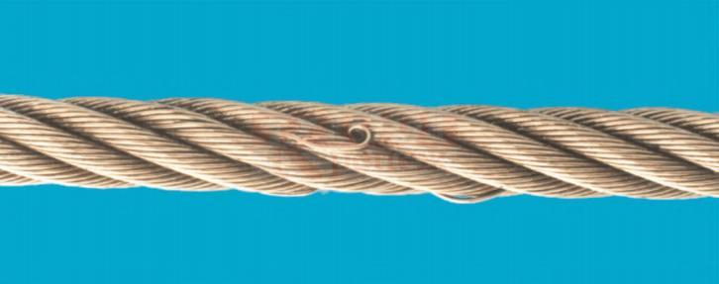
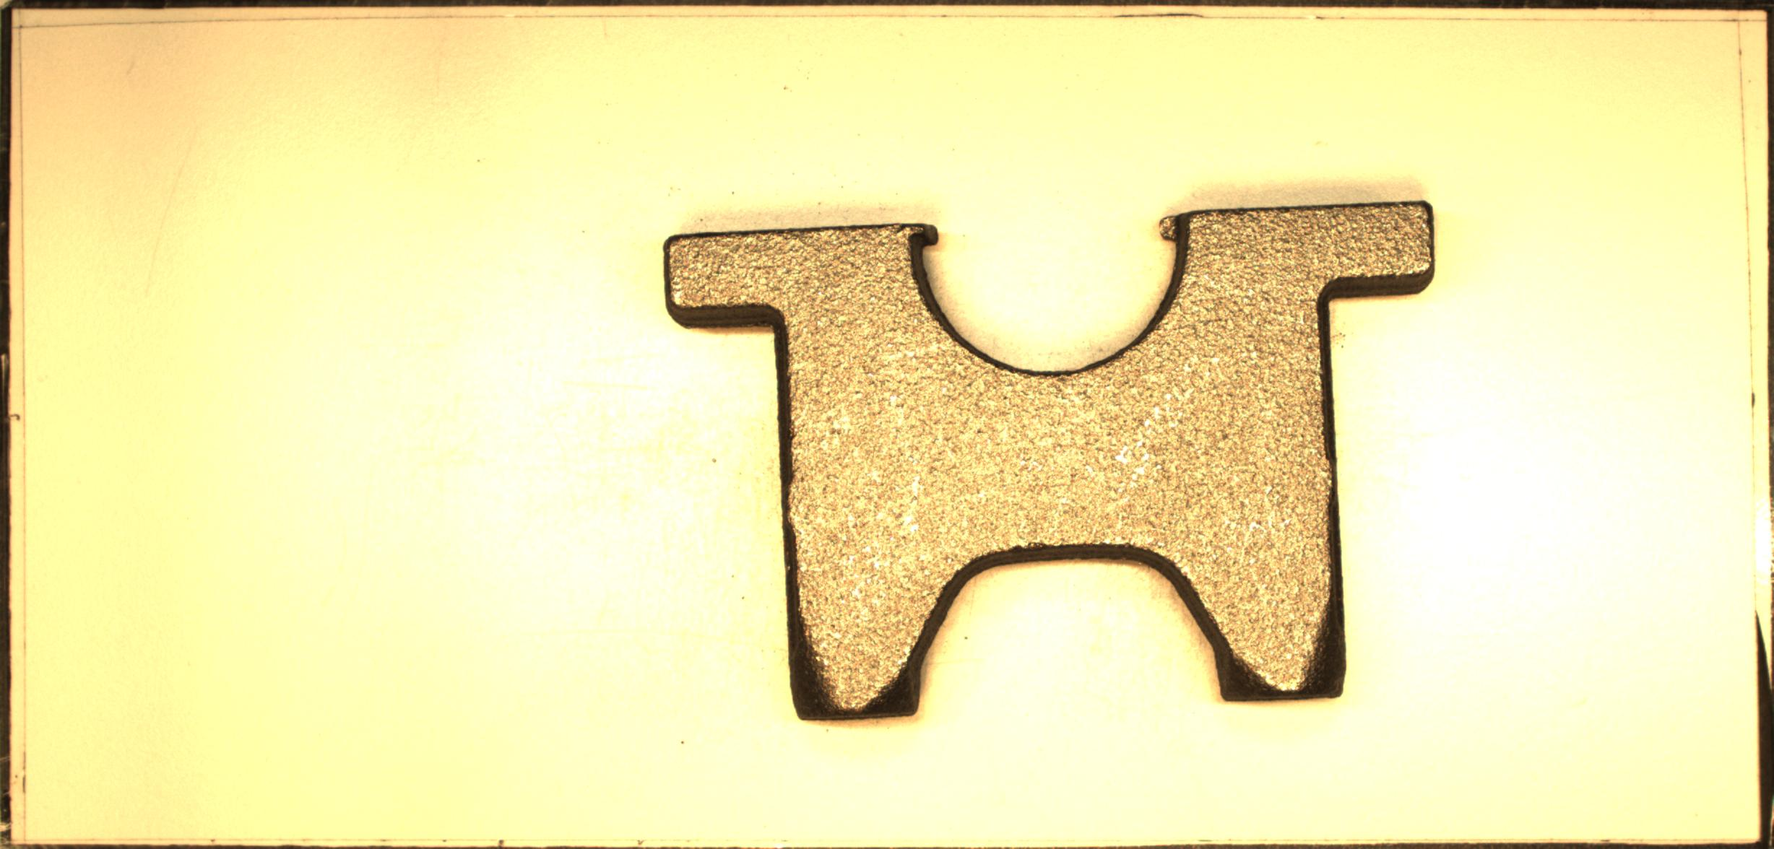
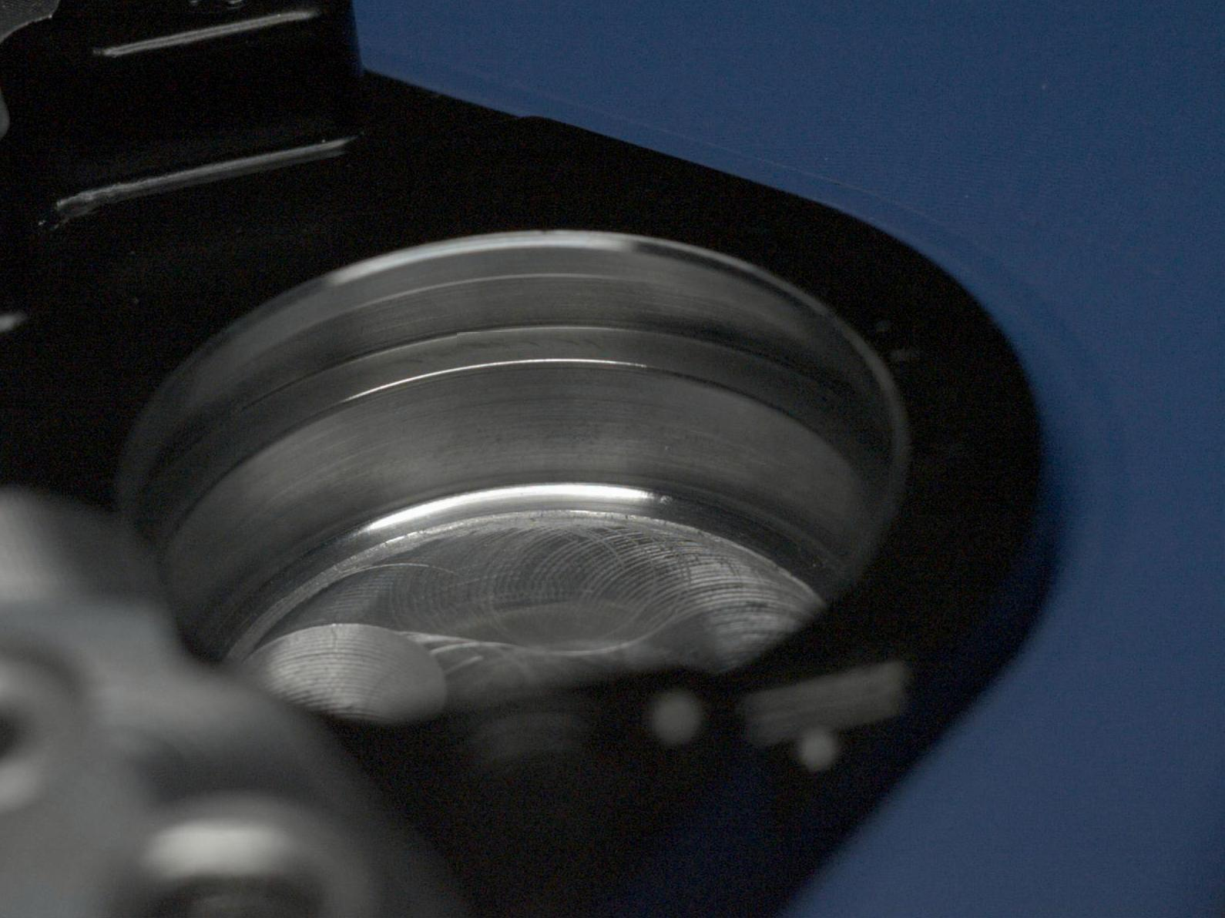
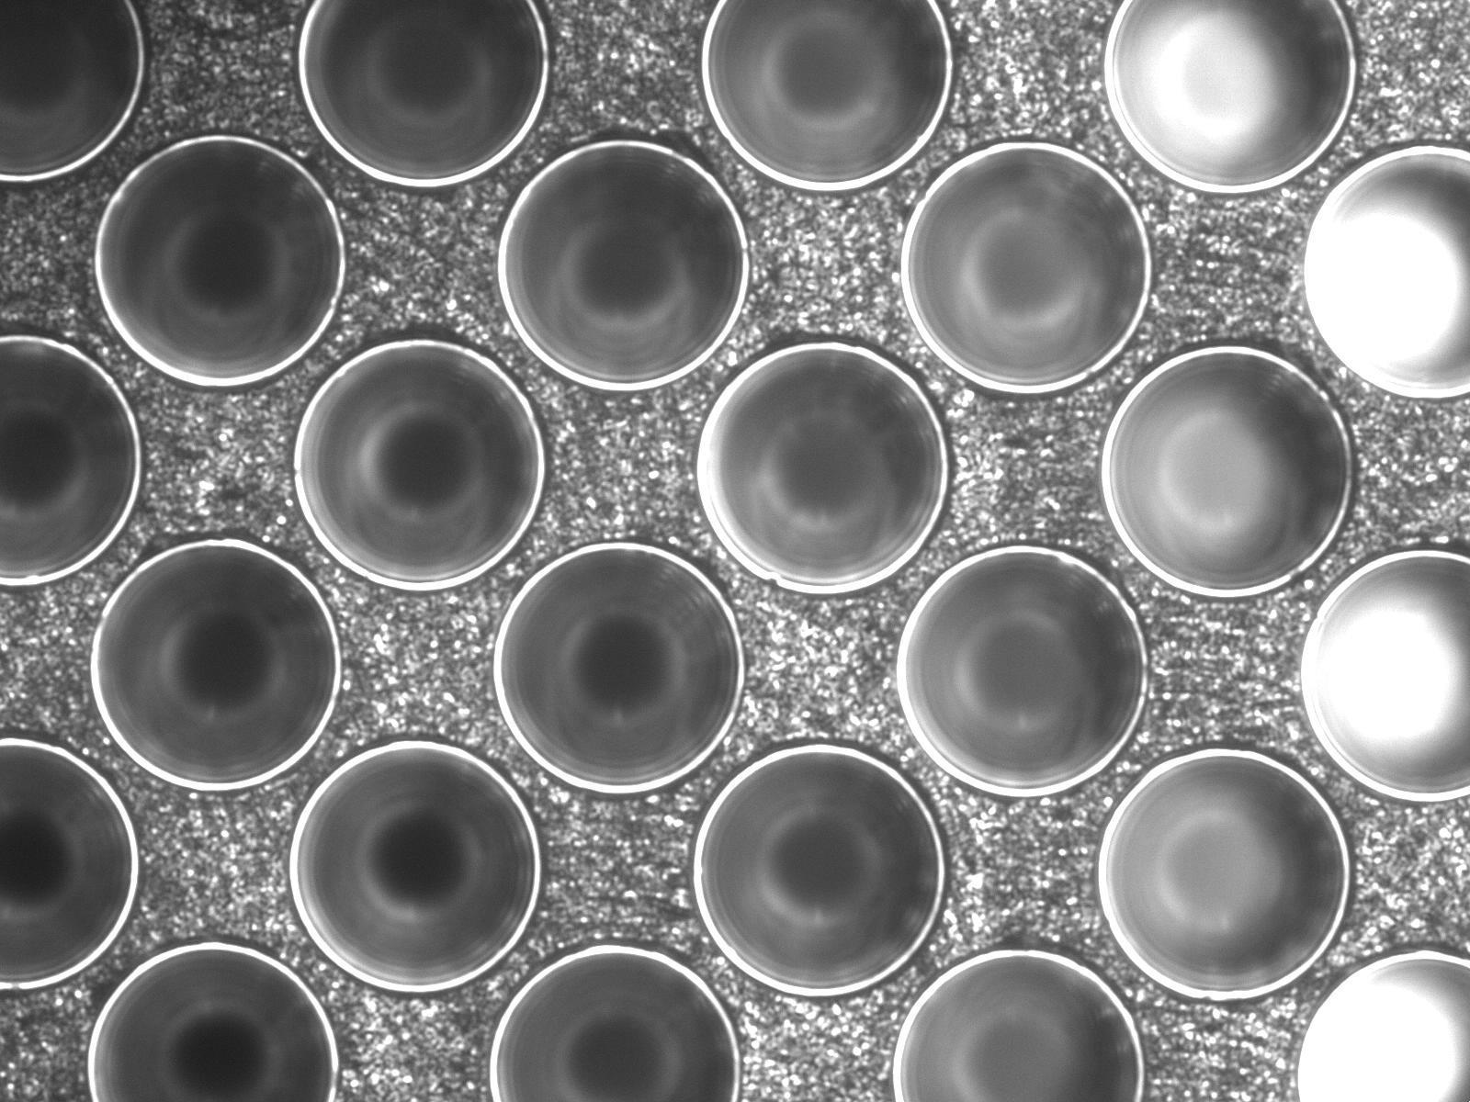
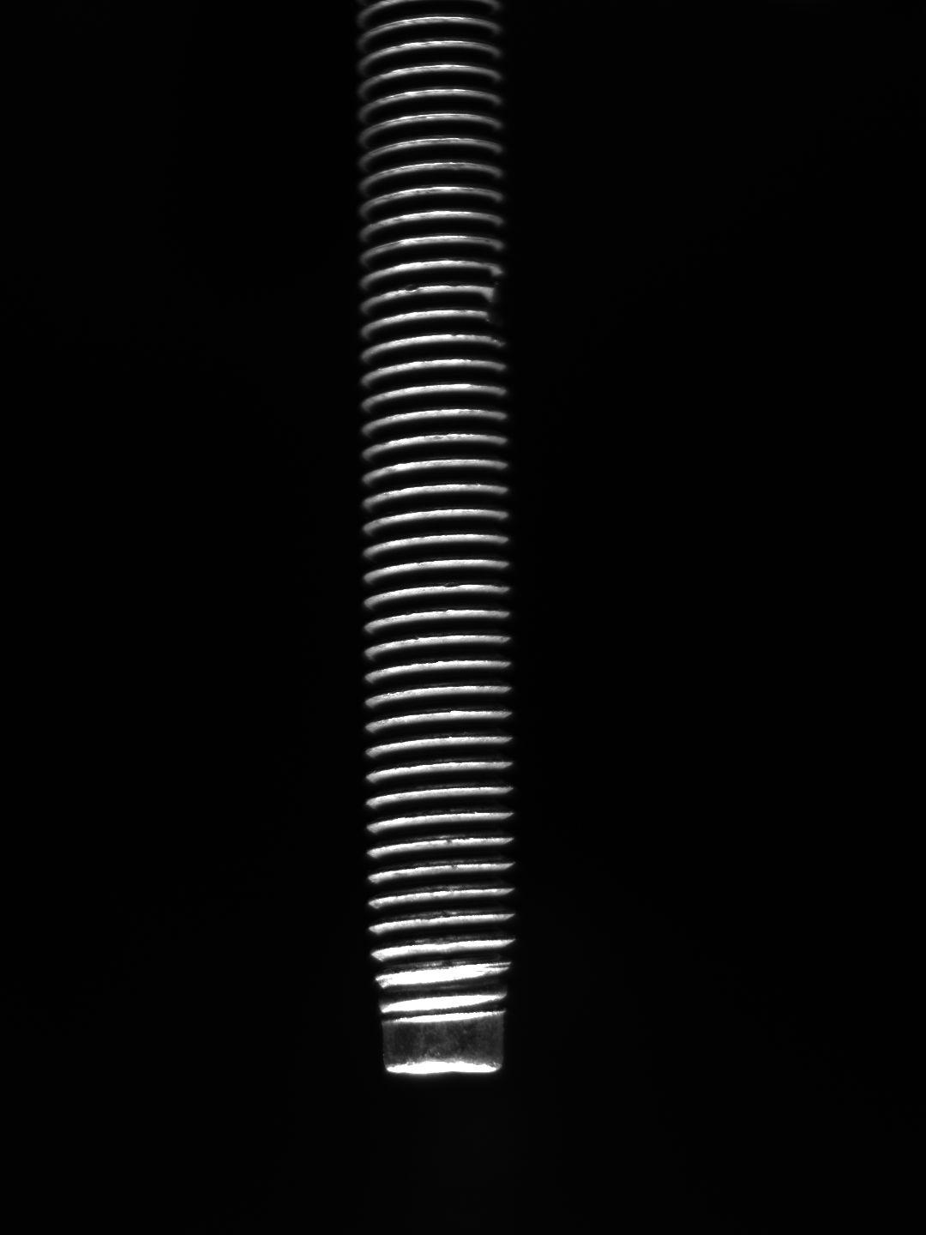
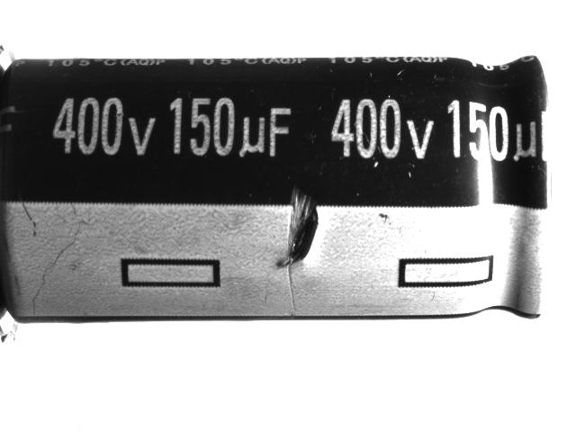
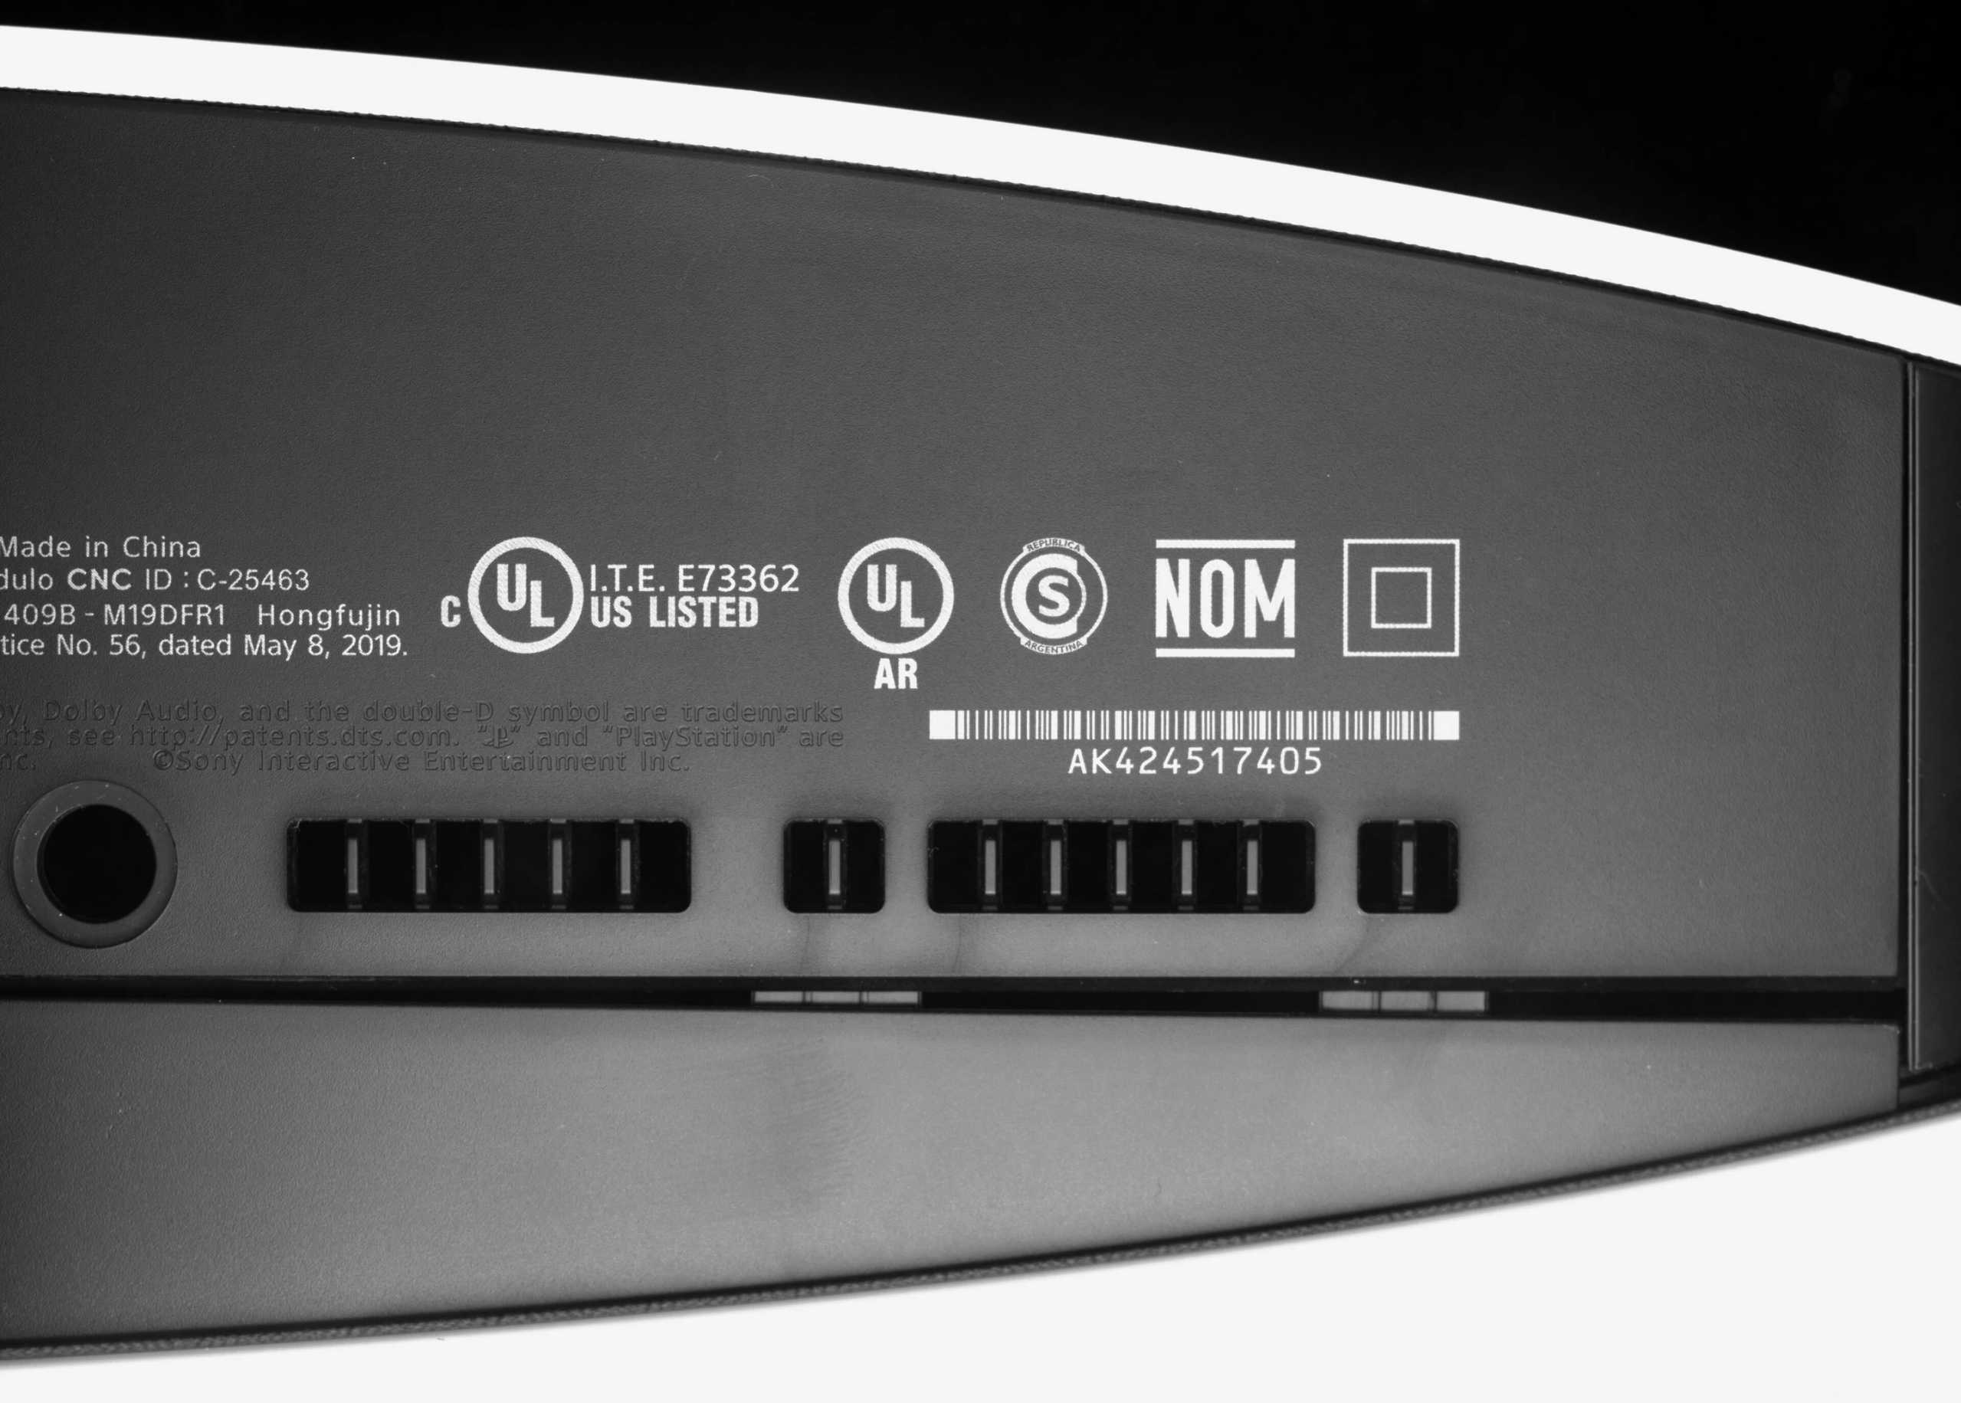
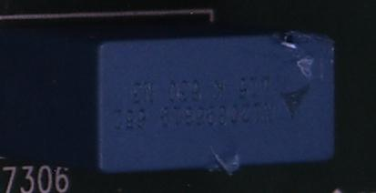
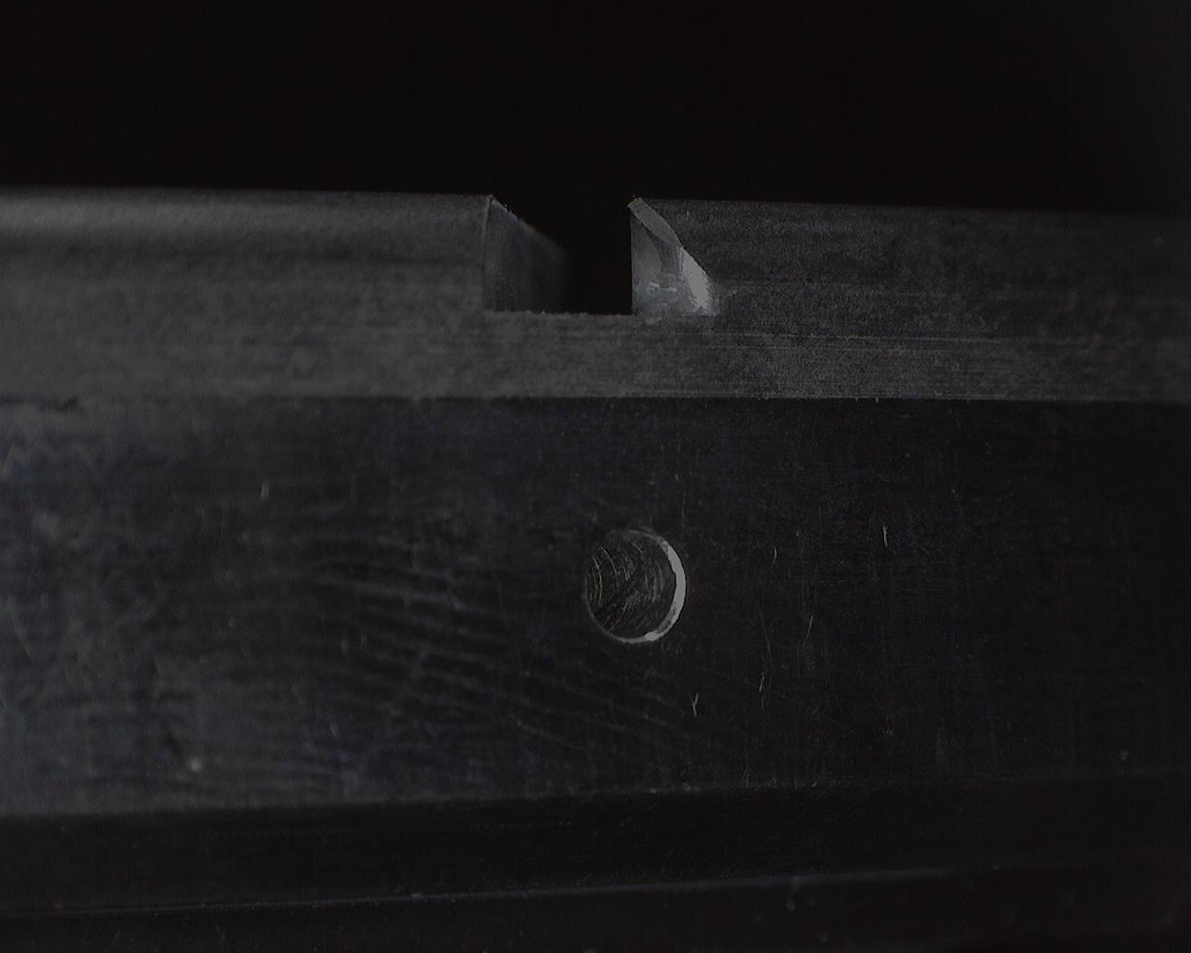
Hybrid Dataset Training
Why?
14 datasets, dozens of defects, few labeled images
Significant difference between defects, therefore no risk of category confusion.
Advantage
Other defect data can be regarded as the background of the current defect class, which greatly enriches the training data
Dataset | train | val | test
Cable | 41 | 131 | 1146
Casting | 54 | 51 | 1755
Cylinder | 138 | 145 | 1241
Capacitor | 35 | 42 | 2257
Console | 95 | 97 | 3936
Electronics | 36 | 31 | 159
Groove | 50 | 49 | 563
Hemisphere | 85 | 134 | 265
Lens | 66 | 63 | 93
PCB_1 | 47 | 40 | 606
PCB_2 | 80 | 75 | 105
Ring | 45 | 42 | 464
Screw | 57 | 63 | 1698
Wood | 51 | 51 | 107
 | 894 | 1029 | 14395

Slide 5
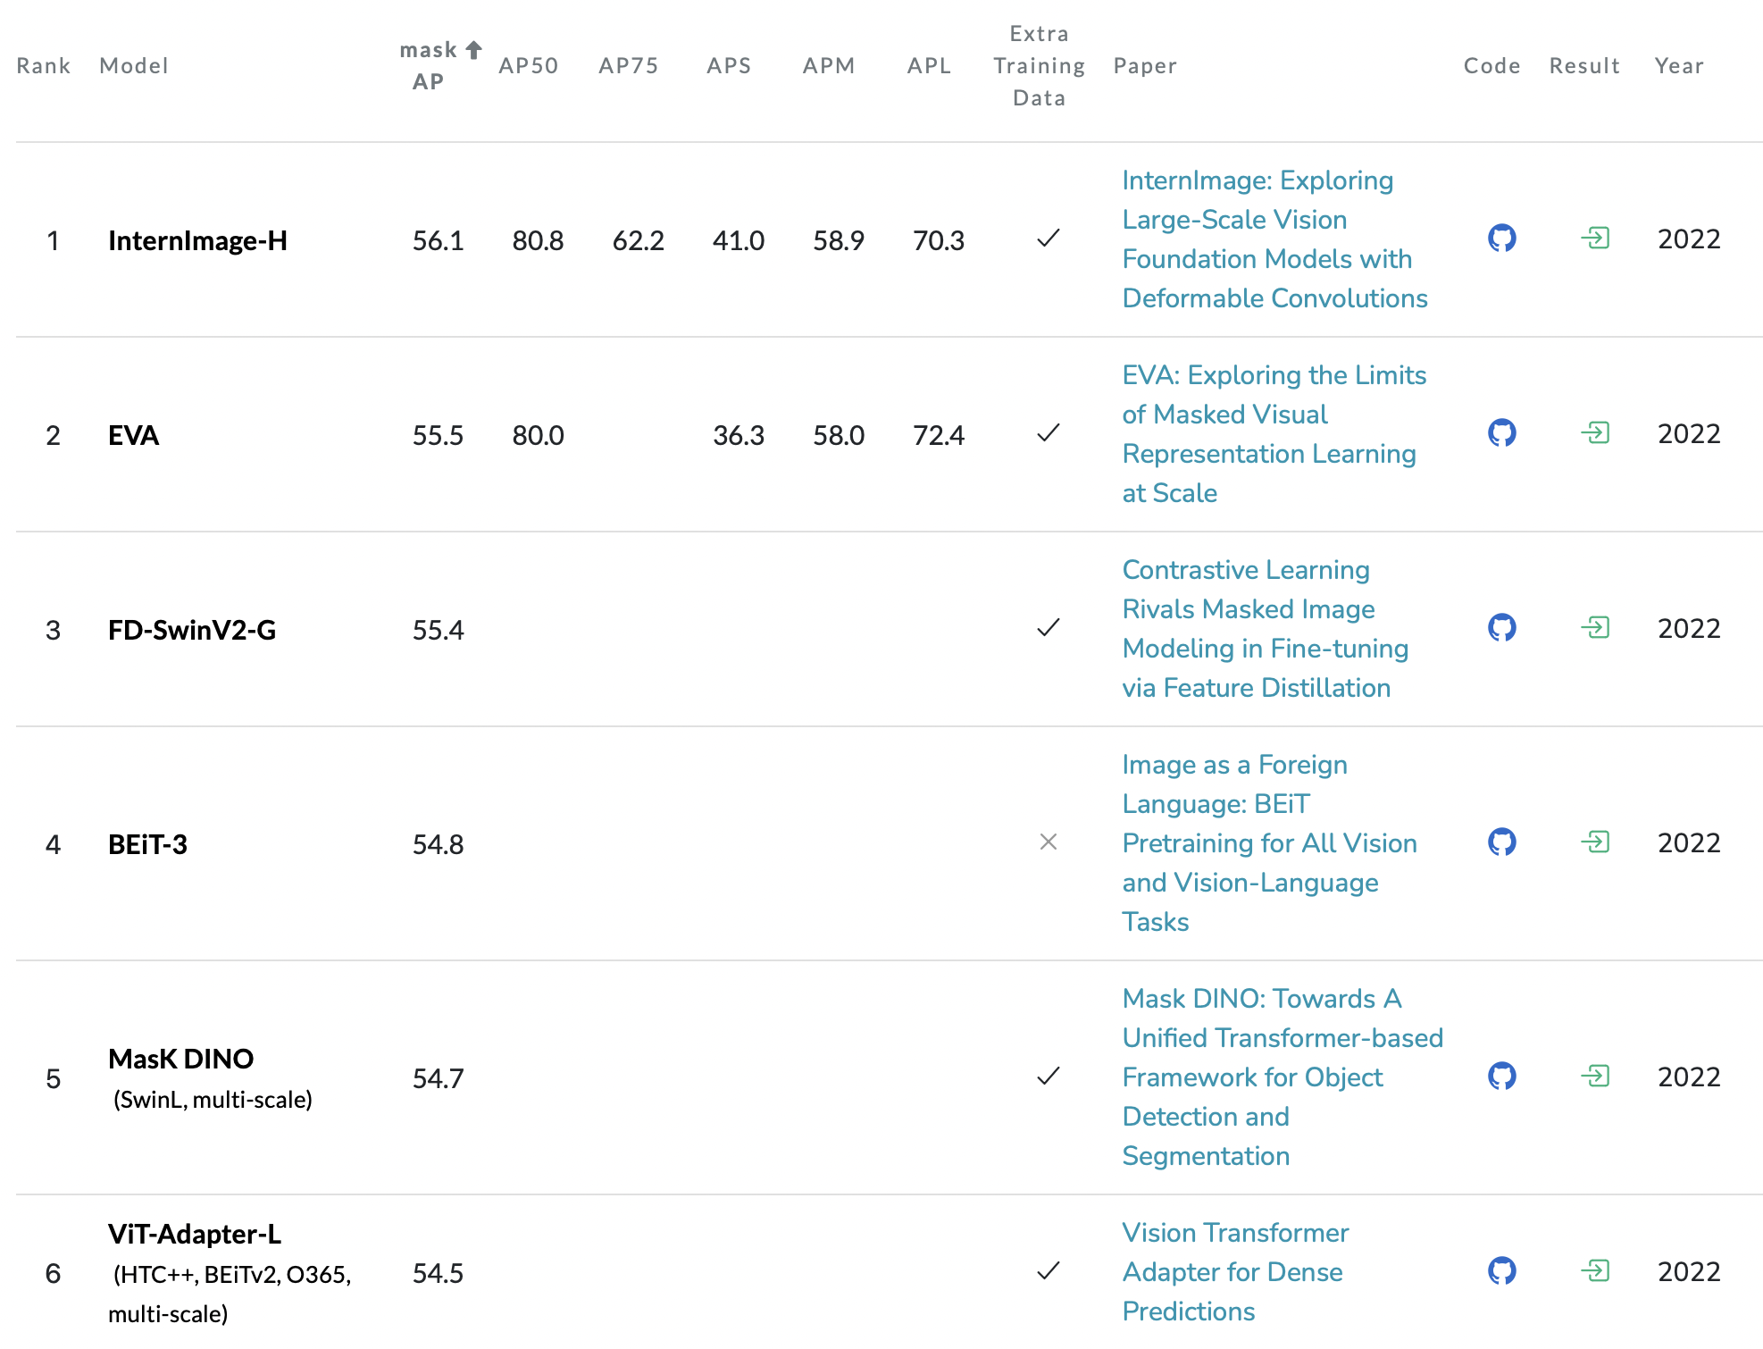
Pre-trained Model Finetuning
Pre-trained models have powerful generalization capabilities, which help the models converge quickly on downstream task datasets and also avoid overfitting when trained on small datasets.
We select pre-trained models based on the public evaluation results on the COCO test-dev dataset.
Referenced from https://paperswithcode.com/sota/instance-segmentation-on-coco
https://cocodataset.org/#home

Slide 6
Heterogeneous model ensemble learning
We select multiple models for ensemble learning to complement each other's strengths and weaknesses.
Classic method Cascade Mask RCNN with EVA
A large-scale pre-trained model EVA with 1.3B parameters is used as backbone
Powerful visual feature extraction capability
SOTA MaskDINO
Transformer-based encoder-decoder
Anchor-Free, NMS-Free；
With a wider receptive field, the segmentation accuracy is
higher;
Cascade Mask RCNN with EVA
EVA
CNN Architecture
Transformer Architecture
Li F, Zhang H, Xu H, et al. Mask dino: Towards a unified transformer-based framework for object detection and segmentation[C]//Proceedings of the IEEE/CVF Conference on Computer Vision and Pattern Recognition. 2023: 3041-3050.
Fang Y, Wang W, Xie B, et al. Eva: Exploring the limits of masked visual representation learning at scale[C]//Proceedings of the IEEE/CVF Conference on Computer Vision and Pattern Recognition. 2023: 19358-19369.

Slide 7
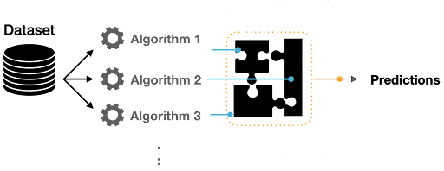
Heterogeneous model ensemble learning
Stacking Ensemble Learning
Train each branch model in parallel and fuse the results of the models
Dataset-aware Checkpoint
The speed of convergence varies depending on defect difficulty, so the model with the highest accuracy for each dataset is stored.
Segmentation Loss
Why?
The final evaluation metrics are only related to the segmentation mask
Modification
The standard segmentation loss function is the CE loss, which does not converge properly on unbalanced data.
$M$ is the number of categories, $y_{ic}$ denotes the label (0 or 1) , $p_{ic}$is the predicted probability that sample $i$belongs to category $c$. We introduce a weighted Dice loss to solve the phenomenon of category imbalance. Suppose the category $y_{ic}$ = 1 denotes the background, then for the background category its $W_{c}$= 0. And for the foreground categories its $W_{c}$= 1.

Slide 8
Result Fusion with Tricks
ROI Filtering
We count the ROIs where each defect appeared based on the labeled images for each dataset. Only the predictions that appeared in the ROIs would be reported.
Score Correction
Furthermore, we statistically calculate the area and the digital number (DN) for each type of defect. The prediction results are weighted according to the area and DN value (0.5+0.5) of the corresponding defect category, and the prediction score of the defect is corrected. The higher the DN value and the larger the area, the higher the corrected prediction scores would be. Finally, the 100 highest scoring predictions are reported for each image.
✕
✓
↑
↓

Slide 9
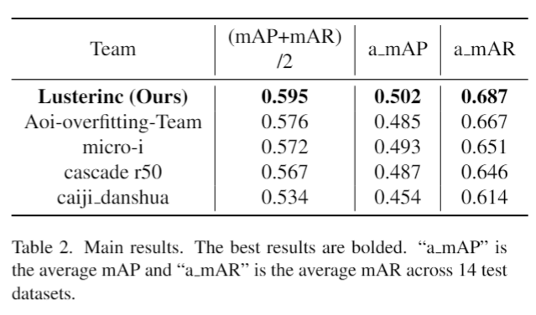
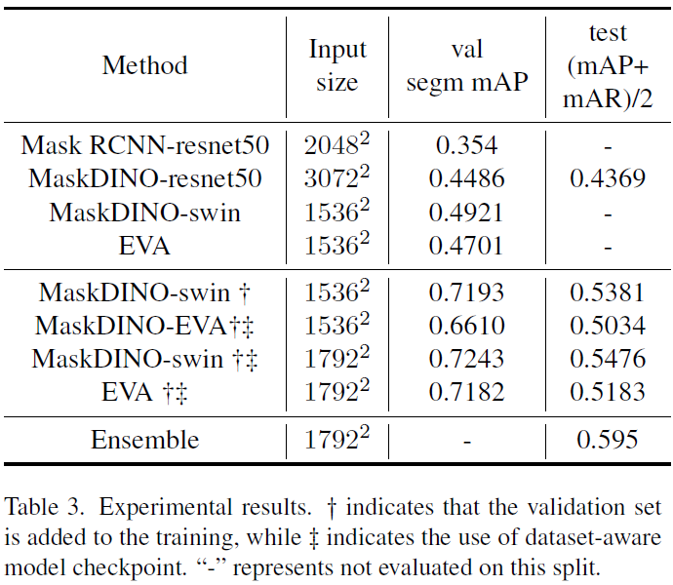
Final Result
With the combination of the above technical points, the final submission of our method ranked first on the leaderboard, achieving 50.2% average mAP and 68.7% average mAR over all 14 test datasets.

Slide 10
THANK YOU
www.lusterinc.com
Notes:
两个最后感谢画面可以选择一个

